Slide 1
NCCPSS Database Design
Capstone Project – DATA 992
Taylor Baldwin | Claudia Dare | Michael Borasy | Usman Siddiqui
Notes:
Usman

Slide 2

Context
What is NCCPSS?
North Carolina Certified Peer Support Specialist (NCCPSS) with UNC School of Social Work and North Carolina Department of Health and Human Services (NCDHHS). The NCCPSS Program certifies persons in recovery from serious mental illness (SMI) and substance use disorders (SUD) to support others on their recovery journey.
UNC School of Data Science & Society
Notes:
Usman

Slide 3




Background
Why A New System is Needed
Growing Data: Years of accumulated program information
Fragmented Systems: Legacy tools solved short-term needs but created data silos
Need for Oversight: Long-term evaluation requires reliable structure
Quality Issues: Siloed data created inefficiencies in the workflow
UNC School of Data Science & Society
Notes:
Usman

Slide 4





Stakeholders Expectations
Data management and system design
Build a structured and scalable database system
Improve data collection, reporting & decision-making
Deliver a solution aligned with real program needs
Support long-term program impact & participant outcomes
Notes:
Usman

Slide 5
Stakeholders
Who Relies on the Data?
UNC School of Social Work
NCCPSS Program Staff
Primary Project Stakeholders
Program Partners, Sponsors, & Trainers
Certified Peer Support Specialists
NCDHHS
Secondary Stakeholders
UNC School of Data Science & Society
Notes:
Usman

Slide 6
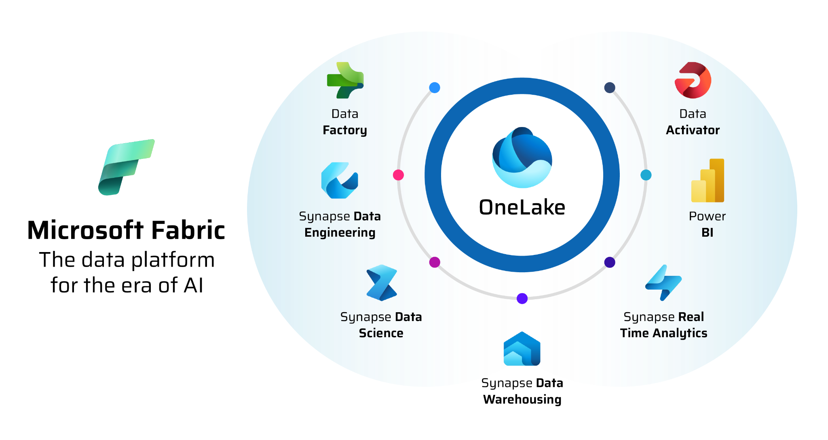
Technology Stack
UNC School of Data Science & Society
Notes:
Claudia

Slide 7
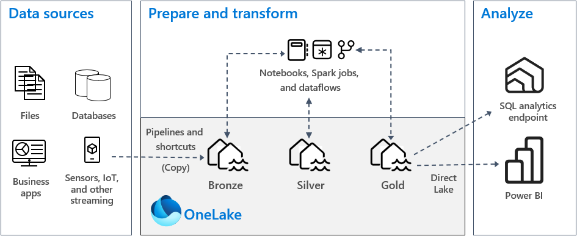
Data Flow
Medallion Architecture in Microsoft Fabric
UNC School of Data Science & Society
Notes:
Claudia
Export data from Access and Drupal
Load raw data into Microsoft Fabric
Clean and standardize fields
Match records and assign unique IDs
Create three connected tables
Use Power BI for reporting and dashboards

Slide 8



Proposed Data Structure
Person
One row per peer with stable identity
Certification Event
One row per certification/recertification
Employment Snapshot
One row per time point capturing employment outcomes
Counties
Accounts for multi-select county feature
UNC School of Data Science & Society
Notes:
Claudia
Add table about multi select counties

Slide 9
Data Pipeline - Full Build
Drupal Data
Drupal Data: Cleaned and Standardized
Merged Initial Table
Access Data
Access Data: Cleaned and Standardized
Data Structure
Building database system with initial datasets
Notes:
Claudia

Slide 10
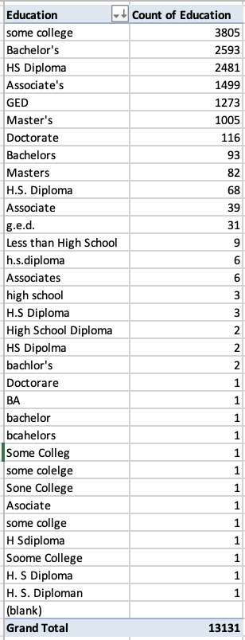
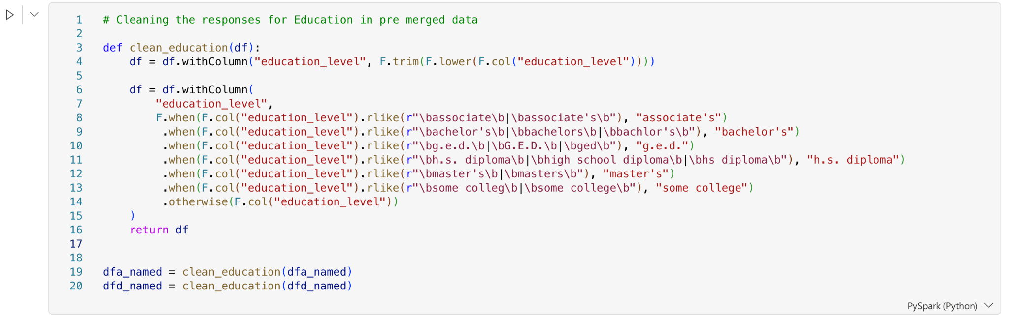
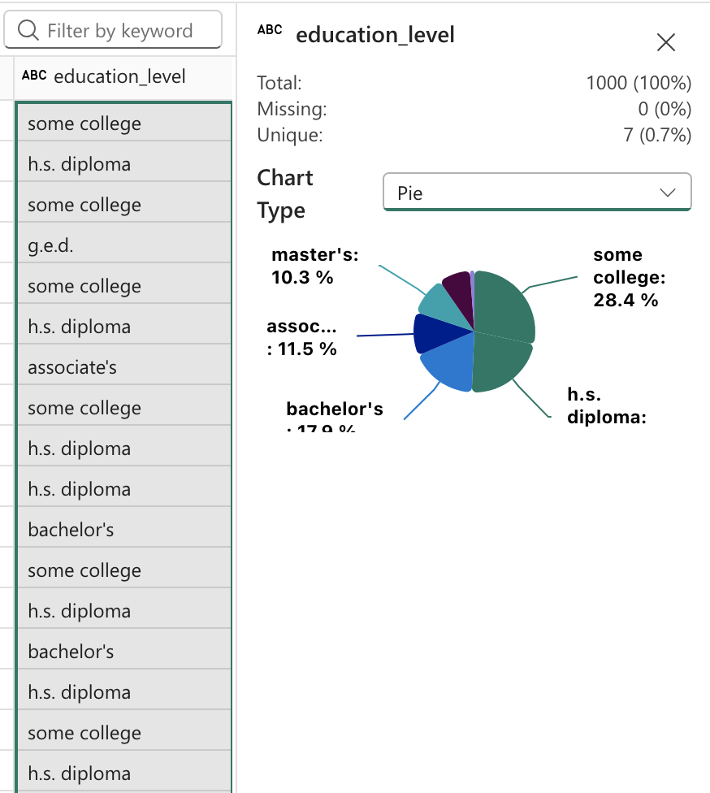
Cleaning and Standardizing Ex
** We also used the package rapidfuzz on our string columns for initial data cleaning**

Slide 11
Incremental Pipeline Overview
Latest Drupal Data
Compare to Existing Data
New/Changed Records
Process Through Silver
Update Gold Tables
Only affected records are processed — no full rebuild required
UNC School of Data Science & Society
Notes:
Michael

Slide 12
How Incremental Processing Works
How it Works
Impact on the System
Compare latest Drupal data to existing processed data
Identify new and changed records
Reprocess only affected individuals
Update Gold tables using merge operations
Avoids reprocessing unchanged records
Improves runtime and efficiency
Scales as data grows
Enables automated updates
UNC School of Data Science & Society
Notes:
Michael

Slide 13
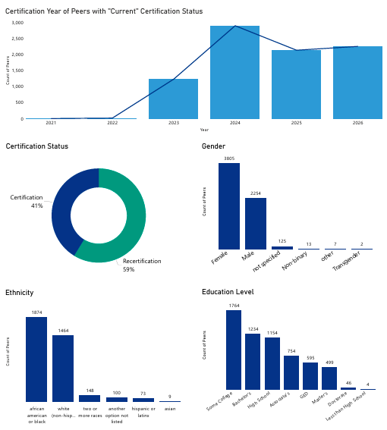
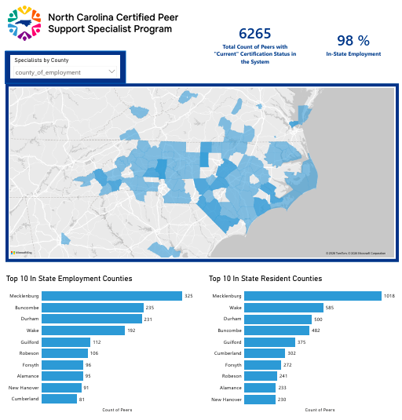
Dashboard Analytics
UNC School of Data Science & Society
Notes:
Taylor

Slide 14
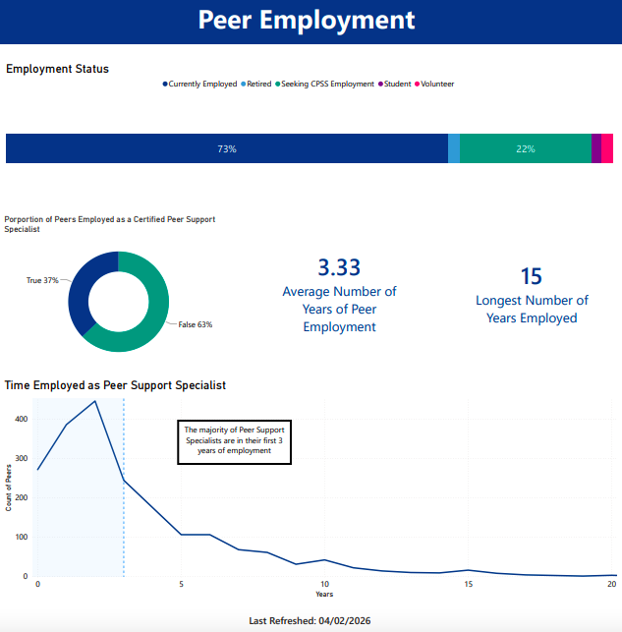

Slide 15
Project Outcomes
What We’ll Deliver
1
Centralized data environment
2
Documentation
3
SQL database
4
Dashboard + insights
UNC School of Data Science & Society
Notes:
Taylor

Slide 16



Project Impact
Centralized & Reliable Data System
Project
Impact
Improved ability to track individuals over time
Better reporting and decision-making
Clear visibility into workforce trends
Foundation for future automation and analytics
UNC School of Data Science & Society
Notes:
Taylor
The project, conducted in partnership with the MADS students, is expected to have a significant positive impact on the NCCPSS Program. By streamlining the database, the program will gain several key benefits:
Enhanced Data-Driven Decision Making: A more organized and accessible database will allow program staff to analyze trends, track participant progress, and identify areas for improvement more efficiently. This will support evidence-based planning and program development.
Improved Reporting: The streamlined system will simplify the generation of reports for continuous quality improvement, partner organizations, and funding agencies. Accurate and timely reporting will improve transparency and demonstrate program effectiveness.
Support for Funding Opportunities: With improved data and reporting capabilities, the program will be better positioned to meet funder expectations, which often require detailed output metrics.
Operational Efficiency: Reducing manual data entry and improving data organization will free up staff time, allowing the team to focus more on training, evaluation, and participant support.
Overall, the partnership with the MADS students is expected to strengthen the NCCPSS Program’s infrastructure, increase its capacity for strategic growth, and enhance its ability to serve participants effectively.

Slide 17
Future Work
Automate Drupal Fabric Ingestion
Replace manual exports with API or connector-based data flow
Enhanced longitudinal tracking with timestamps
Capture certification and employment dates to enable true historical analysis
Expand reporting and trend analysis
Track certification rates, employment outcomes, and retention over time
Explore predictive modeling
Forecast certification success, employment likelihood, and workforce trends
UNC School of Data Science & Society
Notes:
Michael

